Slide 1
PowerPoint slides to accompany
System Dynamics, Third Edition
William J. Palm III
Using Simscape™ Versus Simulink for Modeling the Dynamics of Ladder Networks
Copyright © 2013. The McGraw-Hill Companies, Inc.

Slide 2
These slides are intended to be used with the author’s text, System Dynamics, 3/e, published by McGraw-Hill©2014.
Acknowledgments
The author wishes to acknowledge the support of McGraw-Hill for hosting these slides, and The MathWorks, Inc., who supplied the software. Naomi Fernandes, Dr. Gerald Brusher, and Steve Miller of MathWorks provided much assistance. Dr. Brusher’s contributions formed the basis for many of the Simscape models presented here.
MATLAB®, Simulink®, and Simscape™ are registered trademarks and trademarks of The MathWorks, Inc. and are used with permission.
The equations and math symbols in these slides were created with the new equation editor in PowerPoint 2010, and thus material containing these elements will appear as graphics when viewed in an earlier version.

Slide 3
Simscape™ extends the capabilities of Simulink® by providing tools for modeling and simulation of multi-domain physical systems, such as those with mechanical, thermal, hydraulic, and electrical components. In this presentation, we will demonstrate the advantages of using Simscape instead of Simulink for constructing dynamic models of electrical ladder networks.

Slide 4
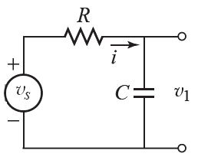
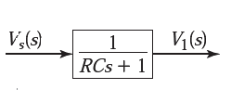
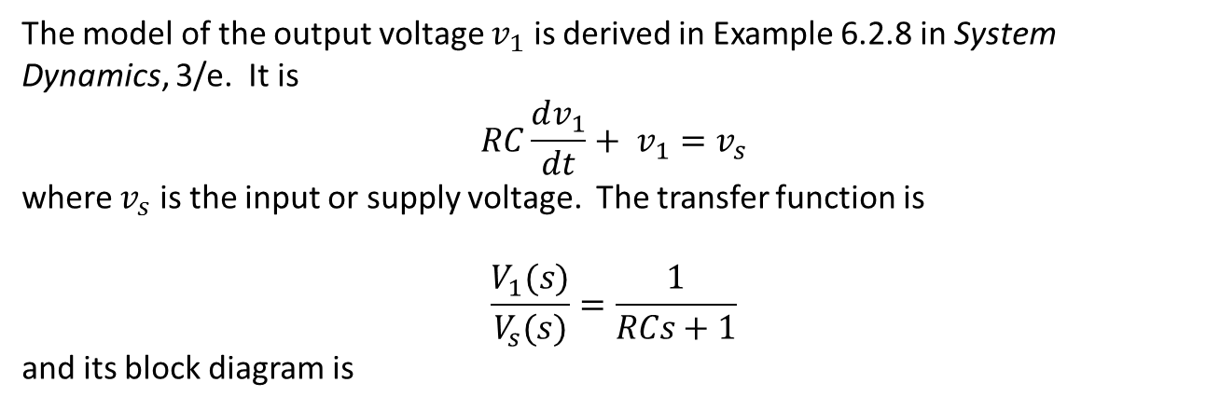
Consider in the RC circuit shown below.
The model of the output voltage $v_{1}$ is derived in Example 6.2.8 in System Dynamics, 3/e. It is
$$RC\frac{dv_{1}}{dt}+ v_{1}=v_{s}$$
where $v_{s}$ is the input or supply voltage. The transfer function is
$$\frac{V_{1}(s)}{V_{s}(s)}=\frac{1}{RCs+1}$$
and its block diagram is

Slide 5
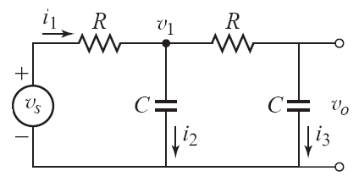
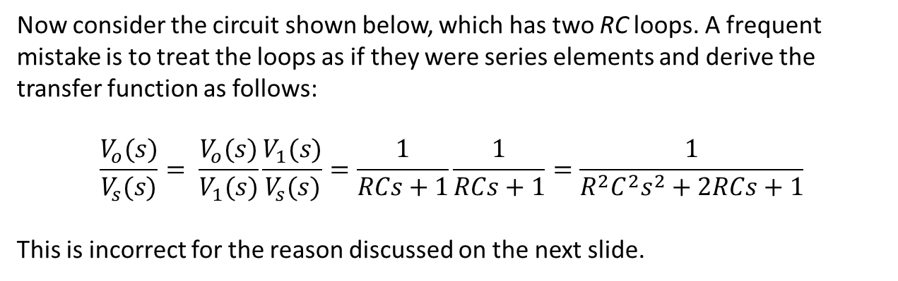
Now consider the circuit shown below, which has two RC loops. A frequent mistake is to treat the loops as if they were series elements and derive the transfer function as follows:
$$\frac{V_{o}(s)}{V_{s}(s)}= \frac{V_{o}(s)}{V_{1}(s)}\frac{V_{1}(s)}{V_{s}(s)}=\frac{1}{RCs+1}\frac{1}{RCs+1}=\frac{1}{R^{2}C^{2}s^{2}+2RCs+1}$$
This is incorrect for the reason discussed on the next slide.

Slide 6

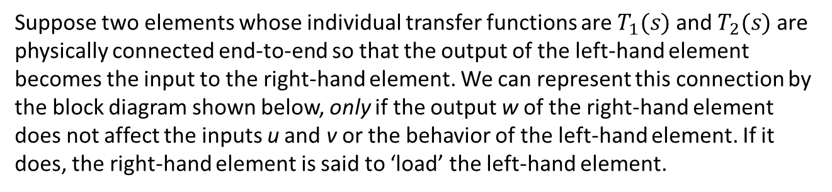
Suppose two elements whose individual transfer functions are $T_{1}(s)$ and $T_{2}(s)$ are
physically connected end-to-end so that the output of the left-hand element becomes the input to the right-hand element. We can represent this connection by the block diagram shown below, only if the output w of the right-hand element does not affect the inputs u and v or the behavior of the left-hand element. If it does, the right-hand element is said to ‘load’ the left-hand element.
This point is illustrated by the example discussed on the following slides, which is Example 6.3.5 in System Dynamics, 3/e.

Slide 7
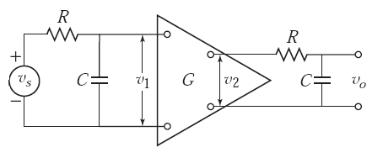
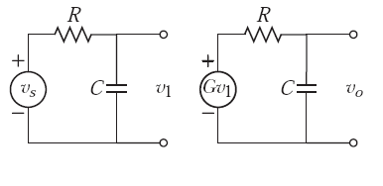
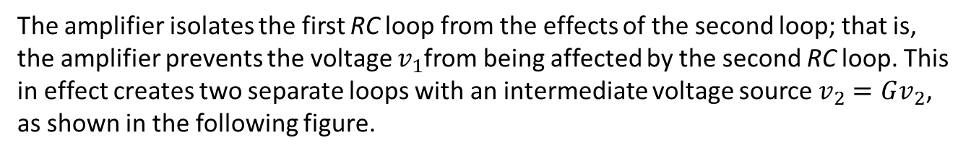
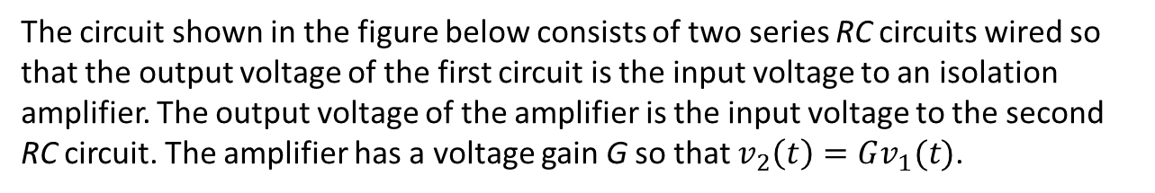
The circuit shown in the figure below consists of two series RC circuits wired so that the output voltage of the first circuit is the input voltage to an isolation amplifier. The output voltage of the amplifier is the input voltage to the second RC circuit. The amplifier has a voltage gain G so that $v_{2}\left(t\right)=Gv_{1}(t)$.
The amplifier isolates the first RC loop from the effects of the second loop; that is, the amplifier prevents the voltage $v_{1}$from being affected by the second RC loop. This in effect creates two separate loops with an intermediate voltage source $v_{2}=Gv_{2}$, as shown in the following figure.

Slide 8
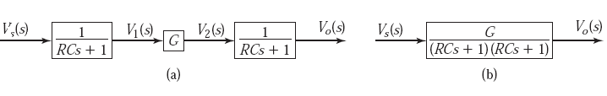
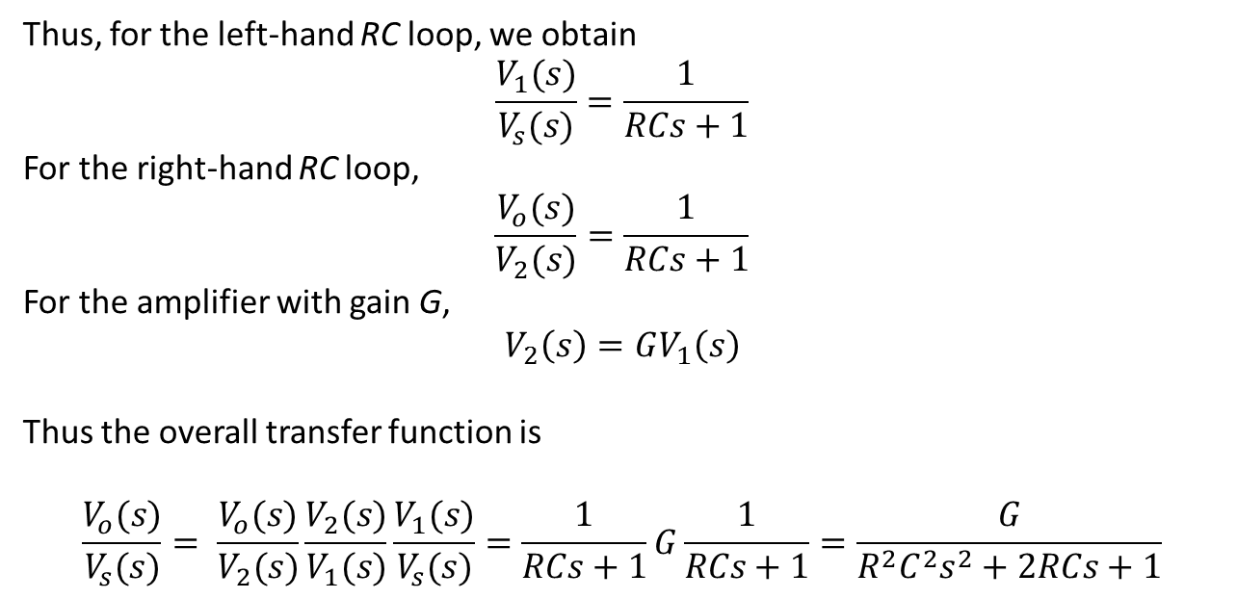
Thus, for the left-hand RC loop, we obtain
$$\frac{V_{1}(s)}{V_{s}(s)}=\frac{1}{RCs+1}$$
For the right-hand RC loop,
$$\frac{V_{o}(s)}{V_{2}(s)}=\frac{1}{RCs+1}$$
For the amplifier with gain G,
$$V_{2}\left(s\right)=GV_{1}\left(s\right)$$
Thus the overall transfer function is
$$\frac{V_{o}(s)}{V_{s}(s)}= \frac{V_{o}(s)}{V_{2}(s)}\frac{V_{2}(s)}{V_{1}(s)}\frac{V_{1}(s)}{V_{s}(s)}=\frac{1}{RCs+1}G\frac{1}{RCs+1}=\frac{G}{R^{2}C^{2}s^{2}+2RCs+1}$$
This procedure is described graphically by the block diagram shown in part (a) of the figure below. The three blocks can be combined into one block as shown in part (b) of the figure.

Slide 9
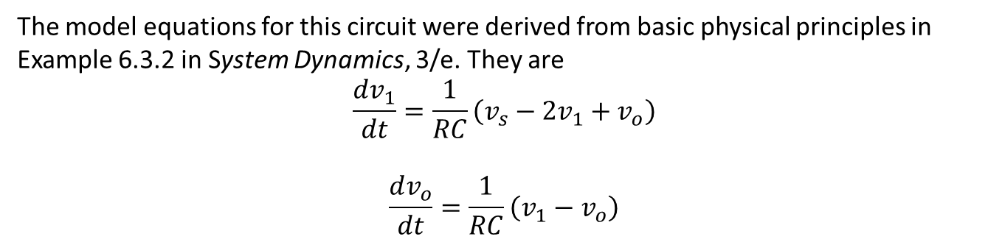
So what about the model of the circuit having two loops, shown below?
The model equations for this circuit were derived from basic physical principles in Example 6.3.2 in System Dynamics, 3/e. They are
$$\frac{dv_{1}}{dt}=\frac{1}{RC}\left(v_{s}−2v_{1}+v_{o}\right)$$
$$\frac{dv_{o}}{dt}=\frac{1}{RC}\left(v_{1}−v_{o}\right)$$

Slide 10
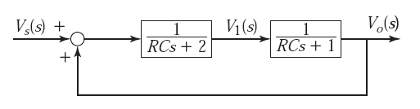


These give:
$$V_{1}(s)=\frac{1}{RCs+2}\left[V_{s}\left(s\right)+V_{o}(s)\right]$$
$$V_{o}\left(s\right)=\frac{1}{RCS+1}V_{1}(s)$$
These form the basis for the following block diagram.
This diagram can be reduced to obtain the transfer function.
$$\frac{V_{o}(s)}{V_{s}(s)}=\frac{1}{R^{2}C^{2}s^{2}+3RCs+1}$$

Slide 11
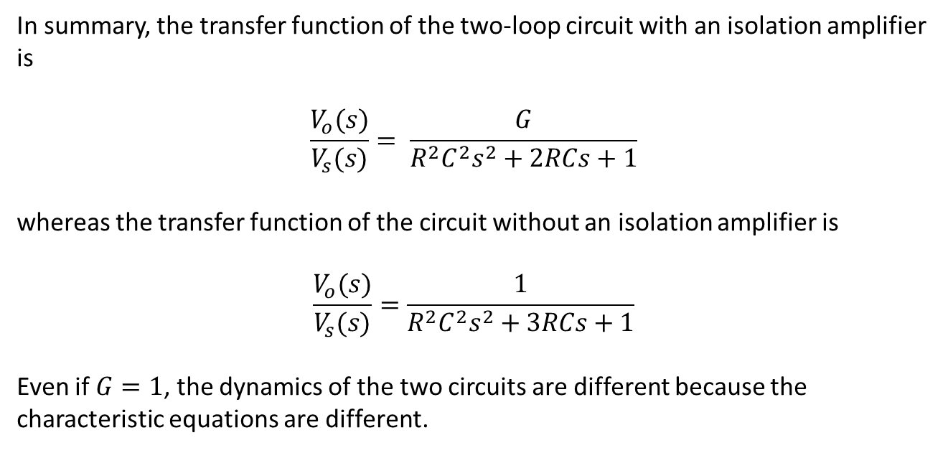
In summary, the transfer function of the two-loop circuit with an isolation amplifier is
$$\frac{V_{o}(s)}{V_{s}(s)}= \frac{G}{R^{2}C^{2}s^{2}+2RCs+1}$$
whereas the transfer function of the circuit without an isolation amplifier is
$$\frac{V_{o}(s)}{V_{s}(s)}=\frac{1}{R^{2}C^{2}s^{2}+3RCs+1}$$
Even if $G=1$, the dynamics of the two circuits are different because the characteristic equations are different.

Slide 12
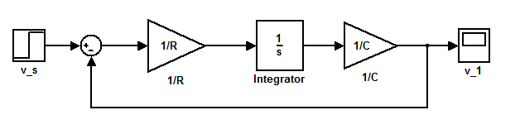
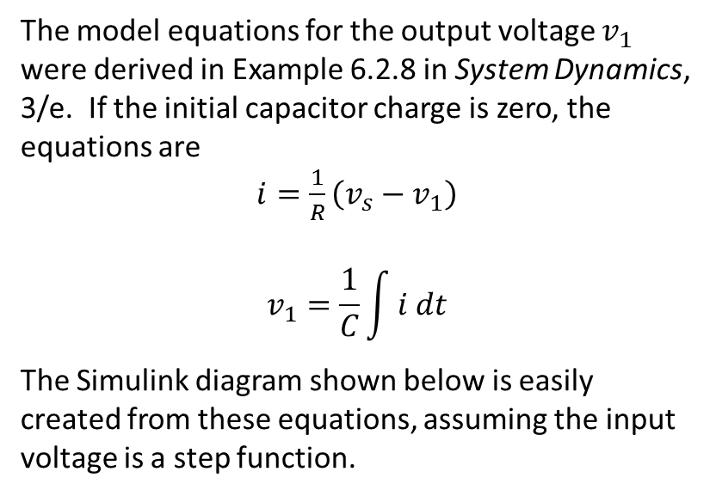
Modeling Ladder Circuits in Simulink
The model equations for the output voltage $v_{1}$ were derived in Example 6.2.8 in System Dynamics, 3/e. If the initial capacitor charge is zero, the equations are
$i=\frac{1}{R}\left(v_{s}−v_{1}\right)$
$$v_{1}=\frac{1}{C}\int{i dt}$$
The Simulink diagram shown below is easily created from these equations, assuming the input voltage is a step function.

Slide 13
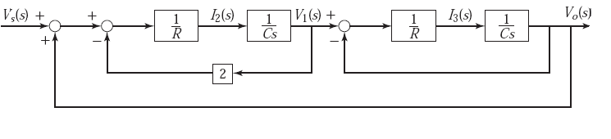
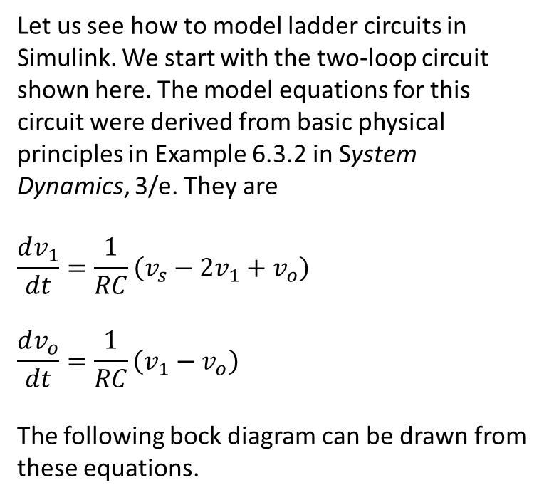
Let us see how to model ladder circuits in Simulink. We start with the two-loop circuit shown here. The model equations for this circuit were derived from basic physical principles in Example 6.3.2 in System Dynamics, 3/e. They are
$$\frac{dv_{1}}{dt}=\frac{1}{RC}\left(v_{s}−2v_{1}+v_{o}\right)$$
$$\frac{dv_{o}}{dt}=\frac{1}{RC}\left(v_{1}−v_{o}\right)$$
The following bock diagram can be drawn from these equations.

Slide 14
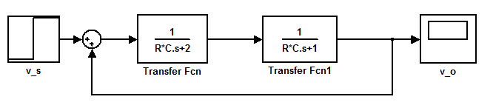
Block diagram algebra can be used to reduce the two inner loops to obtain:
We can continue by reducing the outer loop to obtain a single transfer function, but now the required algebra starts to get complicated. (Think about the algebra required if we had three loops instead of only two.) So instead we will create a Simulink model from this diagram. It is shown below.

Slide 15
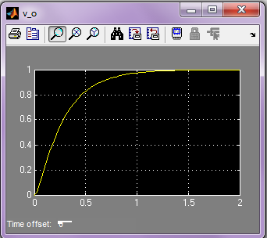
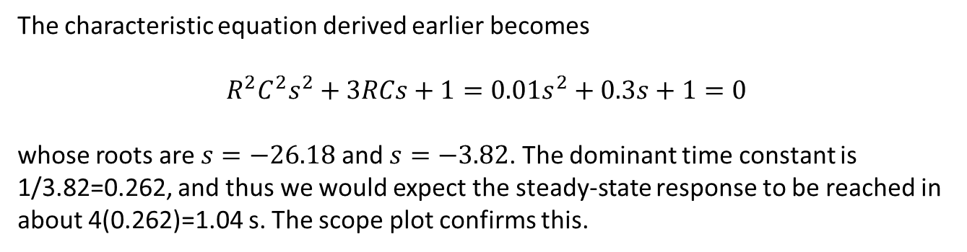
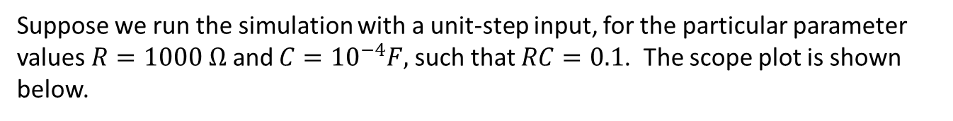
Suppose we run the simulation with a unit-step input, for the particular parameter values $R=1000 Ω$ and $C={10}^{−4}F,$such that $RC=0.1$. The scope plot is shown below.
The characteristic equation derived earlier becomes
$$R^{2}C^{2}s^{2}+3RCs+1=0.01s^{2}+0.3s+1=0$$
whose roots are $s=−26.18$ and $s=−3.82$. The dominant time constant is 1/3.82=0.262, and thus we would expect the steady-state response to be reached in about 4(0.262)=1.04 s. The scope plot confirms this.

Slide 16
Modeling Ladder Circuits in Simscape
We now construct a model of the two-loop circuit in Simscape. The structure of the circuit suggests that we can create a subsystem block that models a single RC loop, and that is what we will do first. Then we will create the complete model by connecting two subsystem blocks.

Slide 17
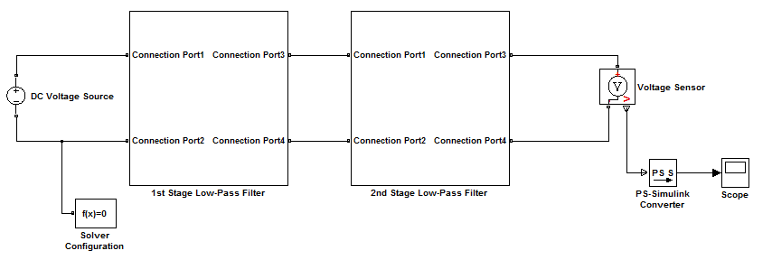
Let us look at the completed model first. It is shown below.
Note that, unlike our Simulink model, there is no feedback loop required in the Simscape diagram. This is due to the fact that the power-conserving connections in Simscape capture the coupling between the loops without the need for feedback signals. This is a great advantage when modeling circuits having many loops.

Slide 18
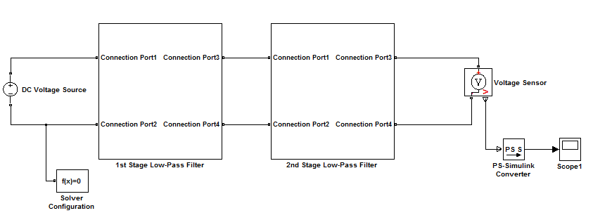
Let us first discuss how to create the subsystem blocks. Later we will discuss the other Simscape elements shown below (the Voltage Source and Sensor, the Solver Configuration, and the PS-Simulink Converter).

Slide 19
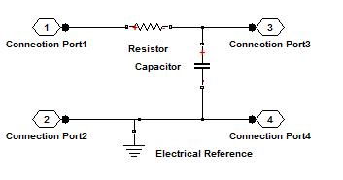
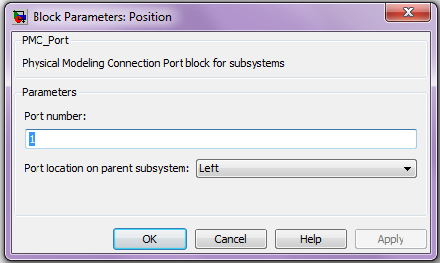
We start with the Simscape model of a single RC loop, shown below.
STEP 1: Select and place the Resistor, Capacitor, and Electrical Reference elements from the Simscape>Foundation Library>Electrical>Electrical Elements library. Rotate the Capacitor block clockwise.
STEP 2: Insert four Physical Modeling Connection Port blocks (PMC_Port) from the Simscape>Utilities library. Place and connect them as shown. You will need to flip blocks 2 and 3. Relabel them as shown. Open the Block Parameters window of each PMC_Port block, verify the port number, and select either Left or Right for the port location, as appropriate. This will identify their connections to another part of the diagram.

Slide 20
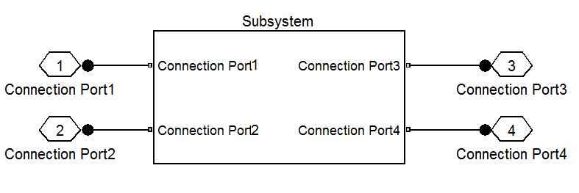
Because this diagram is getting rather detailed, we will now create a subsystem to represent our model thus far. Use a standard Simulink method to do this. For example, use the mouse to enclose all the elements in a bounding box and then select Create Subsystem from the Edit window. You should see the following model.

Slide 21
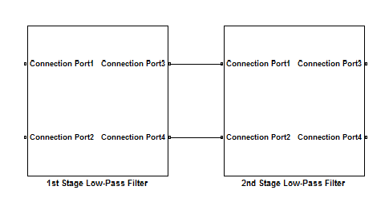
To assemble the system model, delete the port symbols and connect the input and output ports as shown. Notice that the port names match. (This may require editing of PMC port connection names inside one of the subsystems.)

Slide 22
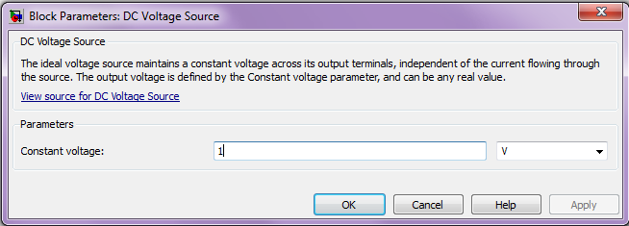
Now select and place the DC Voltage Source element from the
Simscape>Foundation Library>Electrical>Electrical Sources library. This block represents an ideal voltage source that maintains a constant voltage across its output terminals, independent of the current flowing through the source. The output voltage is defined by the Constant voltage parameter. The Block Parameters window is shown below. Enter 1 for the Constant voltage, and select V (the other choices are mV and kV). This indicates that we will be applying a unit-step voltage to the circuit.
Connect the + terminal to port 1 and the – terminal to port 2.

Slide 23
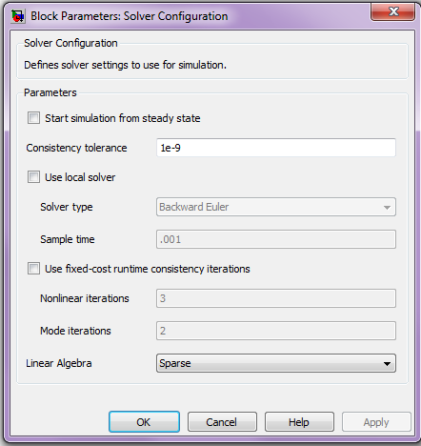
Now select and place a Solver Configuration block from the Simscape>Utilities library.
The Solver Configuration block defines the solver settings for this Simscape physical network. The Simulink solver for the entire model must be set separately. Its Block Parameters window is shown below. For this example, do not change any of the parameters in this block (all three boxes should be unchecked).

Slide 24
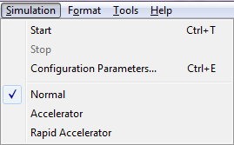
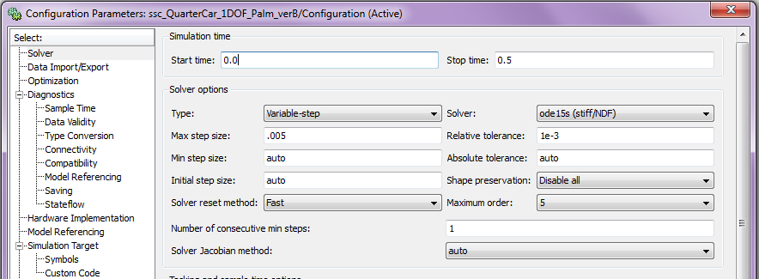
A Note About Solvers: The default solver is ode 45. It is strongly recommended that you change the solver to a stiff solver (ode15s, ode23t, or ode14x). Do this by selecting “Configuration Parameters” from the Simulation menu, selecting the solver pane from the list on the left, and changing the “Solver” parameter to ode15s. Then click OK.

Slide 25
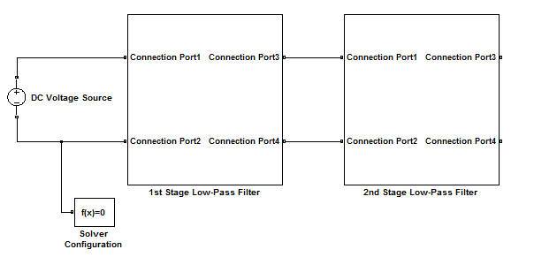
The model should now look like the following.

Slide 26
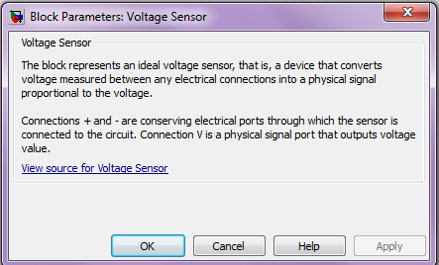
Now select and place the Voltage Sensor element from the
Simscape>Foundation Library>Electrical>Electrical Sensors library. The connections + and - are conserving electrical ports through which the sensor is connected to the circuit. Connection V is a physical signal port that outputs voltage value. The Block Parameters window is shown below. It has no selectable parameters.

Slide 27
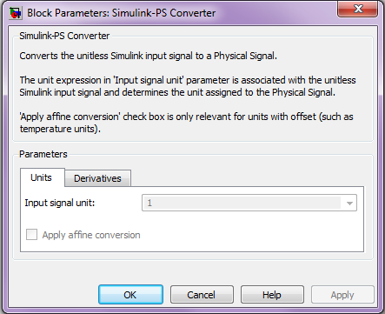
Now select and place the PS-Simulink Converter from the Simscape>Utilities library. This block converts the input physical signal (PS) to a unit-less Simulink output signal. Connect its input to the voltage output port (V) of the voltage sensor. The Block Parameters window is shown below. Enter 1 for the Input signal unit.

Slide 28
Finally, select and place the Scope block from the Simulink>Sinks library. The diagram should now look like the one below.

Slide 29
Setting the Parameter Values: In addition to specifying the Stop Time, to run the simulation we must specify the numerical values of the parameters R and C. One way to do this is to assign values to the variables in the MATLAB® Command window.
However, if you are going to share the model file, a more convenient way is to store the values in the model file itself. You could do this by typing the values in the Block Parameter windows, but then you would not have the variables available for use in another program.
To store the values in the model file, you can create a MATLAB script by selecting Model Properties/Callbacks/InitFcn from the File menu of the model window. We will show how to do this on the following slides.

Slide 30
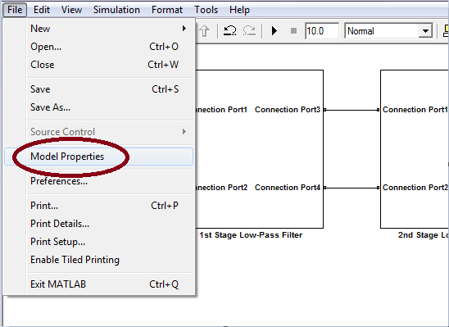
In the Simulink model window, select Model Properties from the File menu:

Slide 31
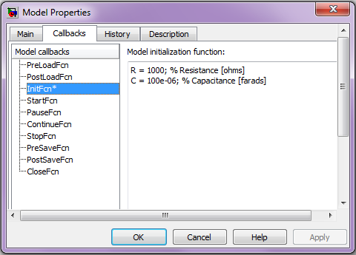
This will bring up the Model Properties dialog box. Select the Callbacks tab. Select InitFcn from the list of Model callbacks. Then, type MATLAB commands into the pane under Model initialization function. These commands will execute at the start of model simulation. Note that an asterisk will appear next to a callback function that has commands written into it.
Type MATLAB commands here.
You then type in the script shown above in the Model initialization function window. This script could also be created in the MATLAB editor and pasted into this window.

Slide 32
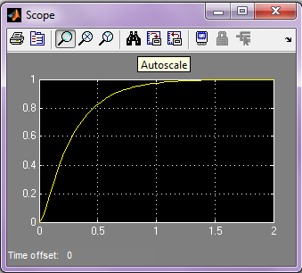
This completes the model. Set the Stop Time to 2 and run the simulation. You should see the following in the scope. The response is identical to that obtained from the Simulink model.

Slide 33
Summary
Suppose we have a circuit with more than two RC loops. We can write the circuit equations for each loop, using the same basic principles we used for a single-loop circuit. Now, however, the number of variables (currents and voltages) becomes quite large, and the algebra required to obtain the overall transfer function becomes very tedious.
Similarly, the block diagram of a multi-loop circuit becomes complicated with multiple feedback loops. The Simulink model has the same problem.
However, unlike block diagram and Simulink models, there are no feedback loops required in the Simscape diagram. This is due to the fact that the power-conserving connections in Simscape capture the coupling between the RC loops without the need for feedback signals. This is a great advantage when modeling circuits having many loops.

Slide 34
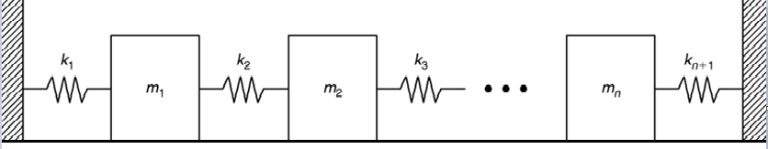
In closing, we note that other physical systems have ladder-like structures, and thus can be more conveniently modeled in Simscape. An example is shown below. Several masses are connected with springs. The motion of each mass is affected by the motion of any adjacent masses. Thus each mass ‘loads’ the adjacent masses, and so we could not use a series transfer function model without feedback loops.
Using Simscape, you would construct a subsystem model consisting of a single mass and spring, and then connect the subsystems to form the model of the entire system. You could also include damping elements between the masses.
This completes the presentation.

